Slide 1
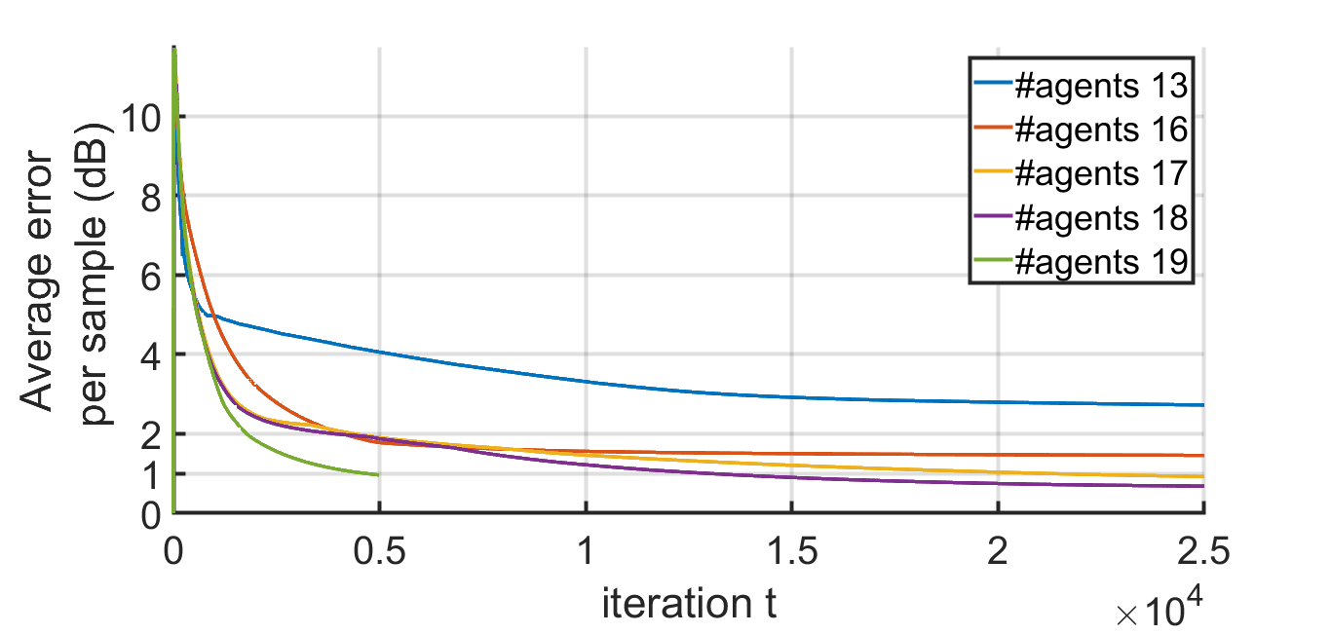
Effect of Number of Agents
randomly placed fixed agents in 2-D
49 receivers
free-space

Slide 2
Effect of Number of Agents

Slide 3
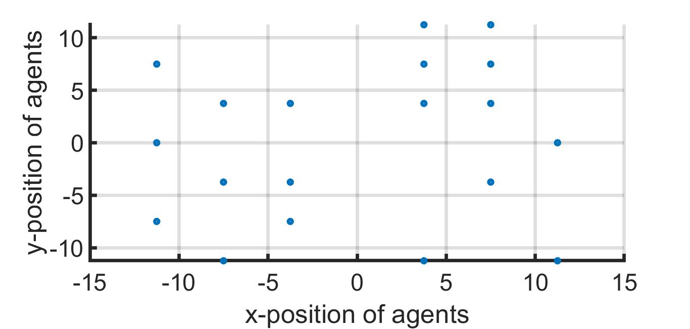
2-D Array

Slide 4
IPG – Frequency Selective Fading

